Slide 2
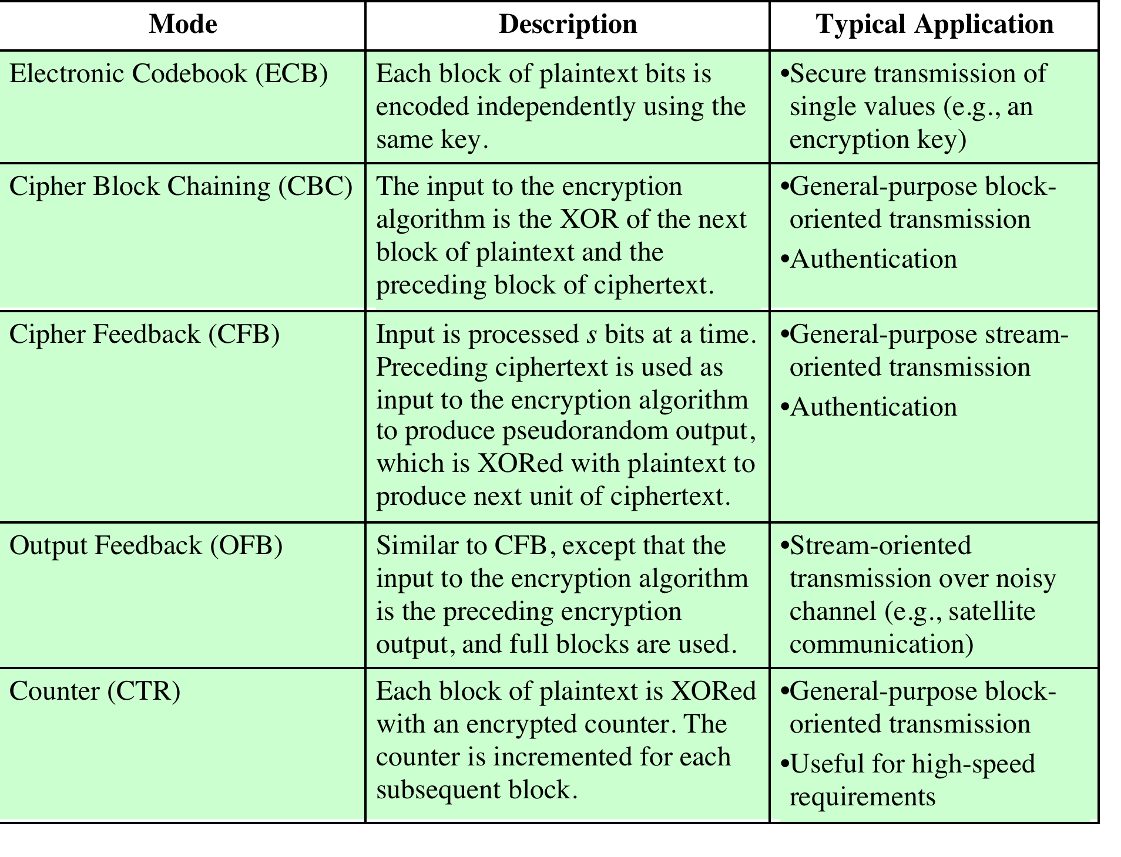
Notes:
The modes are summarized in Table 7.1 and described in this and the following sections.

Slide 3
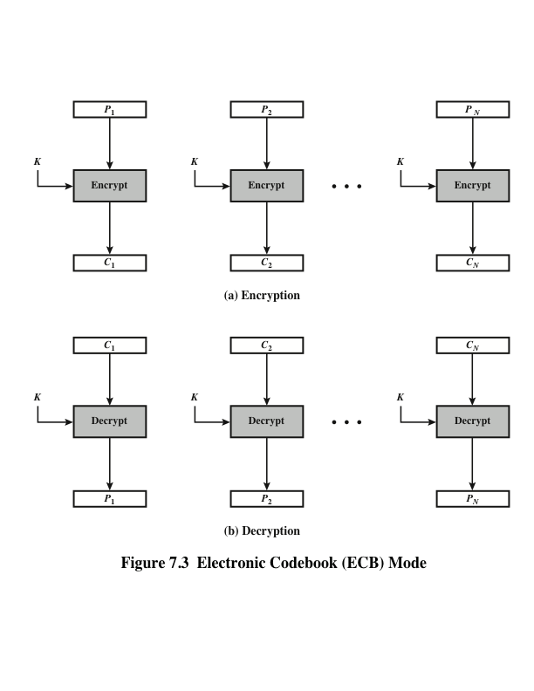
Notes:
The simplest mode is the electronic codebook (ECB ) mode, in which plaintext
is handled one block at a time and each block of plaintext is encrypted using the
same key (Figure 7.3). The term codebook is used because, for a given key, there is
a unique ciphertext for every b -bit block of plaintext. Therefore, we can imagine a
gigantic codebook in which there is an entry for every possible b -bit plaintext pattern
showing its corresponding ciphertext.
For a message longer than b bits, the procedure is simply to break the message
into b -bit blocks, padding the last block if necessary. Decryption is performed one
block at a time, always using the same key. In Figure 7.3, the plaintext (padded as
necessary) consists of a sequence of b -bit blocks, P₁ , P₂ , . . . , P_{N} ; the corresponding
sequence of ciphertext blocks is C₁ , C₂ , . . . , C_{N} . We can define ECB mode as
follows.
ECB C_{j} = E(K, Pj) j = 1, . . . , N P_{j} = D(K, Cj₎ j = 1, . . . , N
The ECB method is ideal for a short amount of data, such as an encryption
key. Thus, if you want to transmit a DES or AES key securely, ECB is the appropriate
mode to use.
The most significant characteristic of ECB is that if the same b -bit block of
plaintext appears more than once in the message, it always produces the same
ciphertext.
For lengthy messages, the ECB mode may not be secure. If the message is
highly structured, it may be possible for a cryptanalyst to exploit these regularities.
For example, if it is known that the message always starts out with certain
predefined fields, then the cryptanalyst may have a number of known plaintext–
ciphertext pairs to work with. If the message has repetitive elements with a
period of repetition a multiple of b bits, then these elements can be identified by the
analyst. This may help in the analysis or may provide an opportunity for substituting
or rearranging blocks.

Slide 4
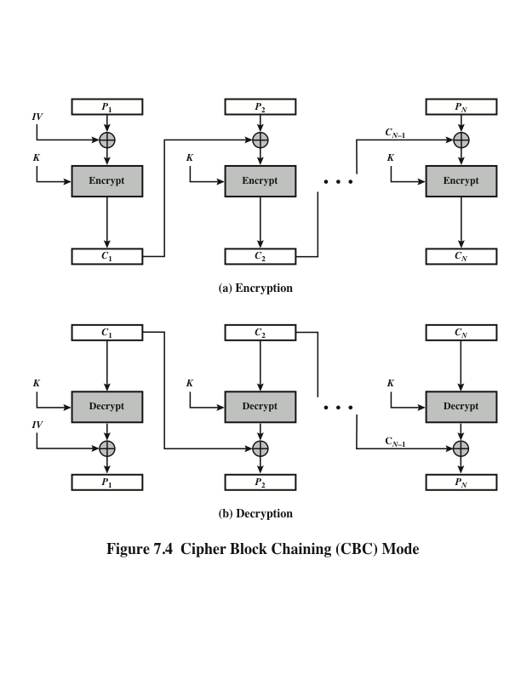
Notes:
To overcome the security deficiencies of ECB, we would like a technique in which
the same plaintext block, if repeated, produces different ciphertext blocks. A
simple way to satisfy this requirement is the cipher block chaining (CBC ) mode
(Figure 7.4). In this scheme, the input to the encryption algorithm is the XOR of the
current plaintext block and the preceding ciphertext block; the same key is used for
each block. In effect, we have chained together the processing of the sequence of
plaintext blocks. The input to the encryption function for each plaintext block bears
no fixed relationship to the plaintext block. Therefore, repeating patterns of b bits
are not exposed. As with the ECB mode, the CBC mode requires that the last block
be padded to a full b bits if it is a partial block.
For decryption, each cipher block is passed through the decryption algorithm.
The result is XORed with the preceding ciphertext block to produce the plaintext
block.
To produce the first block of ciphertext, an initialization vector (IV) is XORed
with the first block of plaintext. On decryption, the IV is XORed with the output
of the decryption algorithm to recover the first block of plaintext. The IV is a data
block that is the same size as the cipher block.
The IV must be known to both the sender and receiver but be unpredictable
by a third party. In particular, for any given plaintext, it must not be possible to
predict the IV that will be associated to the plaintext in advance of the generation
of the IV. For maximum security, the IV should be protected against unauthorized
changes. This could be done by sending the IV using ECB encryption. One reason
for protecting the IV is as follows: If an opponent is able to fool the receiver into
using a different value for IV, then the opponent is able to invert selected bits in the
first block of plaintext.
So long as it is unpredictable, the specific choice of IV is unimportant.
SP800-38A recommends two possible methods: The first method is to apply the
encryption function, under the same key that is used for the encryption of the plaintext,
to a nonce . The nonce must be a data block that is unique to each execution of
the encryption operation. For example, the nonce may be a counter, a timestamp, or
a message number. The second method is to generate a random data block using a
random number generator.
In conclusion, because of the chaining mechanism of CBC, it is an appropriate
mode for encrypting messages of length greater than b bits.
In addition to its use to achieve confidentiality, the CBC mode can be used for
authentication. This use is described in Chapter 12.

Slide 5
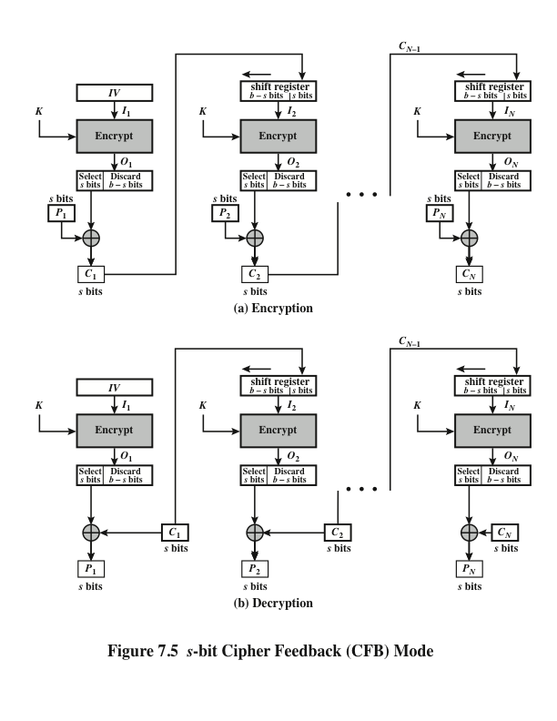
Notes:
Figure 7.5 depicts the CFB scheme. In the figure, it is assumed that the unit of
transmission is s bits; a common value is s = 8. As with CBC, the units of plaintext
are chained together, so that the ciphertext of any plaintext unit is a function of all
the preceding plaintext. In this case, rather than blocks of b bits, the plaintext is
divided into segments of s bits.
First, consider encryption. The input to the encryption function is a b -bit shift
register that is initially set to some initialization vector (IV). The leftmost (most
significant) s bits of the output of the encryption function are XORed with the
first segment of plaintext P₁ to produce the first unit of ciphertext C₁ , which is then
transmitted. In addition, the contents of the shift register are shifted left by s bits,
and C₁ is placed in the rightmost (least significant) s bits of the shift register. This
process continues until all plaintext units have been encrypted.
For decryption, the same scheme is used, except that the received ciphertext
unit is XORed with the output of the encryption function to produce the plaintext
unit. Note that it is the encryption function that is used, not the decryption function.
Although CFB can be viewed as a stream cipher, it does not conform to the
typical construction of a stream cipher. In a typical stream cipher, the cipher takes
as input some initial value and a key and generates a stream of bits, which is then
XORed with the plaintext bits (see Figure 4.1). In the case of CFB, the stream of
bits that is XORed with the plaintext also depends on the plaintext.
In CFB encryption, like CBC encryption, the input block to each forward
Cipher function (except the first) depends on the result of the previous forward
Cipher function; therefore, multiple forward cipher operations cannot be performed
in parallel. In CFB decryption, the required forward cipher operations can be performed
in parallel if the input blocks are first constructed (in series) from the IV and
the ciphertext.

Slide 6
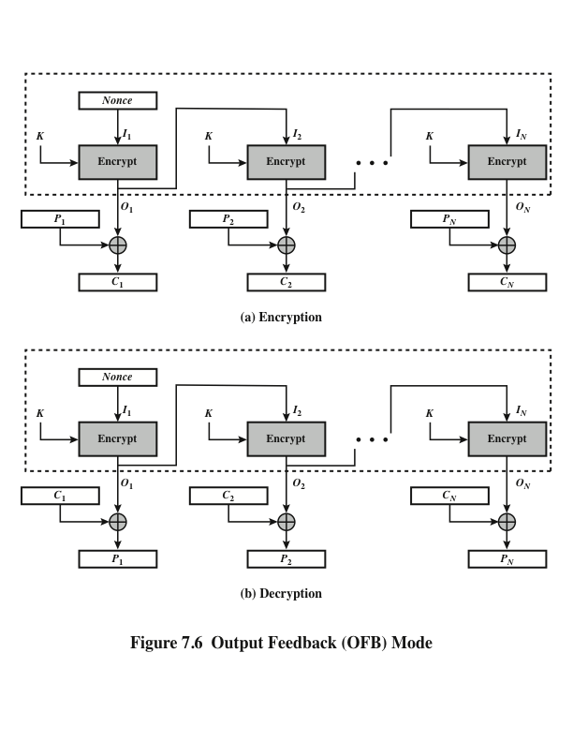
Notes:
The output feedback (OFB) mode is similar in structure to that of CFB. For OFB,
the output of the encryption function is fed back to become the input for encrypting
the next block of plaintext (Figure 7.6). In CFB, the output of the XOR unit is fed
back to become input for encrypting the next block. The other difference is that the
OFB mode operates on full blocks of plaintext and ciphertext, whereas CFB operates
on an s -bit subset.
As with CBC and CFB, the OFB mode requires an initialization vector. In
the case of OFB, the IV must be a nonce; that is, the IV must be unique to each
execution of the encryption operation. The reason for this is that the sequence of
encryption output blocks, O_{i} , depends only on the key and the IV and does not depend
on the plaintext. Therefore, for a given key and IV, the stream of output bits
used to XOR with the stream of plaintext bits is fixed. If two different messages had
an identical block of plaintext in the identical position, then an attacker would be
able to determine that portion of the O_{i} stream.
One advantage of the OFB method is that bit errors in transmission do not
propagate. For example, if a bit error occurs in C₁ , only the recovered value of P₁ is
affected; subsequent plaintext units are not corrupted. With CFB, C₁ also serves as
input to the shift register and therefore causes additional corruption downstream.
The disadvantage of OFB is that it is more vulnerable to a message stream
modification attack than is CFB. Consider that complementing a bit in the ciphertext
complements the corresponding bit in the recovered plaintext. Thus, controlled
changes to the recovered plaintext can be made. This may make it possible for an
opponent, by making the necessary changes to the checksum portion of the message
as well as to the data portion, to alter the ciphertext in such a way that it is not detected
by an error-correcting code. For a further discussion, see [VOYD83].
OFB has the structure of a typical stream cipher, because the cipher generates
a stream of bits as a function of an initial value and a key, and that stream of
bits is XORed with the plaintext bits (see Figure 4.1). The generated stream that is
XORed with the plaintext is itself independent of the plaintext; this is highlighted
by dashed boxes in Figure 7.6. One distinction from the stream ciphers we discuss
in Chapter 8 is that OFB encrypts plaintext a full block at a time, where typically a
block is 64 or 128 bits. Many stream ciphers encrypt one byte at a time.

Slide 7
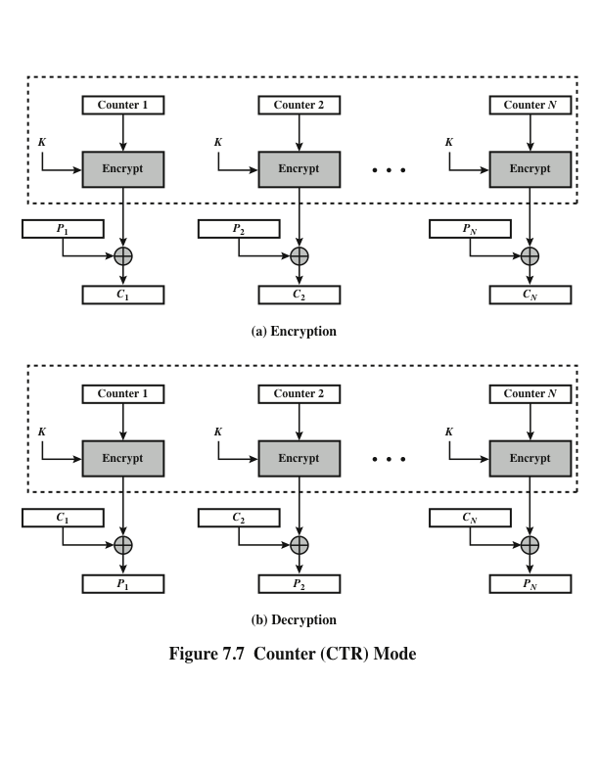
Notes:
Although interest in the counter (CTR) mode has increased recently with applications
to ATM (asynchronous transfer mode) network security and IP sec (IP security),
this mode was proposed early on (e.g., [DIFF79]).
Figure 7.7 depicts the CTR mode. A counter equal to the plaintext block
size is used. The only requirement stated in SP 800-38A is that the counter value
must be different for each plaintext block that is encrypted. Typically, the counter
is initialized to some value and then incremented by 1 for each subsequent block
(modulo 2^{b} , where b is the block size). For encryption, the counter is encrypted and
then XORed with the plaintext block to produce the ciphertext block; there is no
chaining. For decryption, the same sequence of counter values is used, with each encrypted
counter XORed with a ciphertext block to recover the corresponding plaintext
block. Thus, the initial counter value must be made available for decryption.
As with the OFB mode, the initial counter value must be a nonce; that is, T₁
must be different for all of the messages encrypted using the same key. Further,
all T_{i} values across all messages must be unique. If, contrary to this requirement, a
counter value is used multiple times, then the confidentiality of all of the plaintext
blocks corresponding to that counter value may be compromised. In particular, if
any plaintext block that is encrypted using a given counter value is known, then
the output of the encryption function can be determined easily from the associated
ciphertext block. This output allows any other plaintext blocks that are encrypted
using the same counter value to be easily recovered from their associated ciphertext
blocks.
One way to ensure the uniqueness of counter values is to continue to increment
the counter value by 1 across messages. That is, the first counter value of the
each message is one more than the last counter value of the preceding message.

Slide 8
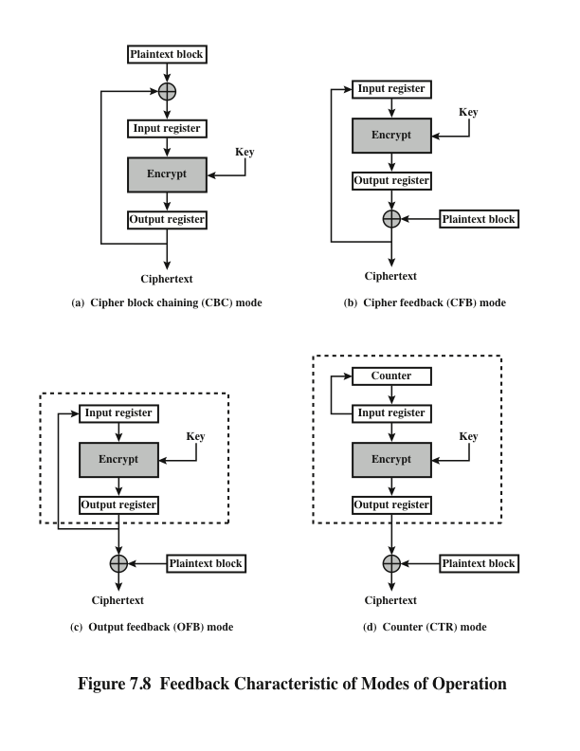
Notes:
Note that, with the exception of ECB, all of the NIST-approved block
cipher modes of operation involve feedback. This is clearly seen in Figure 7.8. To
highlight the feedback mechanism, it is useful to think of the encryption function
as taking input from a input register whose length equals the encryption block
length and with output stored in an output register. The input register is updated
one block at a time by the feedback mechanism. After each update, the encryption
algorithm is executed, producing a result in the output register. Meanwhile,
a block of plaintext is accessed. Note that both OFB and CTR produce output
that is independent of both the plaintext and the ciphertext. Thus, they are natural
candidates for stream ciphers that encrypt plaintext by XOR one full block
at a time.

